Slide 1
Washington LEGISLATIVE Update Election Year, Tax and Estate Planning Hopes, Fears and Existential Dread
Financial Professionals Association
of Northeast Ohio
May 16, 2024
Matthew f. kadish
Partner, Frantz ward llp
president, small business council of America (SBCA)

Slide 2
ROADMAP
Politics
Who Are We? (Key social forces and why they matter)
Congress
House vs. Senate:
Majority / power / procedure
Late 2022
Now (2023-2024)
2025?
Legislation
Recent (late 2021-to date)
Forecasts for legislation
2024
2025 (TCJA sunsets)
2026 – forward
2024 Election
Congressional
Presidential

Slide 3
SETTING THE TABLE

Slide 4
Initial observations
Standard disclaimers
The presentation is intended to be a bi/non-partisan analysis.
I’m not selling candidates or sides; they’re all awful

Slide 5
Initial observations
Standard disclaimers
The presentation is intended to be a bi/non-partisan analysis.
I’m not selling candidates or sides; they’re all awful
The views expressed here are mine alone and not those of Frantz Ward, the SBCA, or of any political party or candidate.

Slide 6
Initial observations
Standard disclaimers
Bi/non-partisan analysis: not selling candidates or sides; they’re all awful
The “nice way” vs the “interesting way”
“If you don’t have something nice to say about someone, come sit next to me” (Alice Roosevelt Longworth)
Political logic vs. Intellectual logic
US Constitution – representative democracy
Symbiosis and interchangeability between the “leaders” and the “led”
Pollsters role and failings. And the alternatives are…?
Role of Money vs. Role of Power – examples:
NYC vs DC
Bloomberg
Trump ($540m in fines and counting)
Message matters (quantity, quality and timing)
Who are we – and is it changing?
Extrinsic vs. intrinsic values
Winning, hating, collaborating
Sports analogy
Irony (or “boring stuff you hate will come back to bite you”)
High School Civic Class (Colonel Bauer’s last laugh)

Slide 7
USa OR Dsa -- Then (1860-1865: civil war)
1860 – a country already divided
North (urban, industrial)
South (rural, agricultural)
Human rights vs. property rights
Stifling debate over volatile issues
“Gag” rule – barred reading antislavery petitions on House floor (1836-1844)
Numerous fights between congressman (1856 caning of Sen. Sumner)**
Perforation already in place: the Mason-Dixon Line
Origin: property dispute between colonies of PA and MD (1767)
Missouri Compromise of 1820 (slave/free states boundary)
Election of 1860:
Lincoln was the more moderate of two abolitionist candidates
Sought to stop expansion of slavery into territories
Secession of South began before Lincoln was even sworn in (December 20, 1860)
Civil War:
Began: April 12, 1861 (Confederate troops fired on Fort Sumter in SC)
Ended: May 9, 1865 (Surrender at Appomattox)
**For more, see https://newrepublic.com/article/151817/violence-broke-congress) and https://www.thenation.com/article/archive/the-history-of-congressional-mayhem/

Slide 8
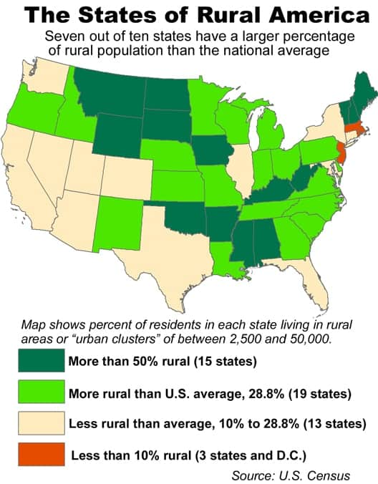
USa OR Dsa -- now
2021 – a country still divided
Urban vs. Rural
Establishment vs. anti-establishment
Suppression of discussion of volatile issues; lack of dialogue
Gaps:
Wealth Gap
“Kids: you’ll catch up with Elon Musk if you:
Save $1m per year
For 240,000 years”
Success Gap (“K” shaped recovery) // Racial Gap
Empathy Gap (listening only to positions we agree with / “teach me”)
End game?
We can’t just do a Mason-Dixon line on this – most states are internally split
Resolution via
Dialogue vs. divisiveness (Biden’s 2020 campaign vs. 2022 MAGA speech),
Conflict,
Timothy McVeigh (OKC bombing) and “Turner Diaries”
Trump statement about McConnell’s “death wish”
Compromise,
Or rely on evolution (the “ostrich approach”)

Slide 9
Federalist papers – power to the people?
Unresolved issues from formation of our country have remained that way
Populism vs. “Strong Executive”
Power vs. Policy
“Federalist Papers”: 85 articles and essays written (under pseudonym Publius) by Alexander Hamilton, James Madison, and John Jay in advance of the ratification of the U.S. Constitution.
“It has been frequently remarked, that it seems to have been reserved to the people of this country, by their conduct and example, to decide the important question, whether societies of men are really capable or not, of establishing good government from reflection and choice, or whether they are forever destined to depend, for their political constitutions, on accident and force” [from Federalist No. 1]

Slide 10
hope, fear + existential dread

Slide 11
EXISTENTIAL DREAD:
“There is great power in ignorance”
Kay : We do not discharge our weapons in view of the public!
Jay : Man, we ain't got time for this cover-up bullshit! I don't know whether or not you've forgotten, but there's an Arquillian Battle Cruiser that's about to...
Kay : There's always an Arquillian Battle Cruiser, or a Corillian Death Ray, or an intergalactic plague that is about to wipe out all life on this miserable little planet, and the only way these people can get on with their happy lives is that they DO NOT KNOW ABOUT IT!
Men in Black (1997)

Slide 12
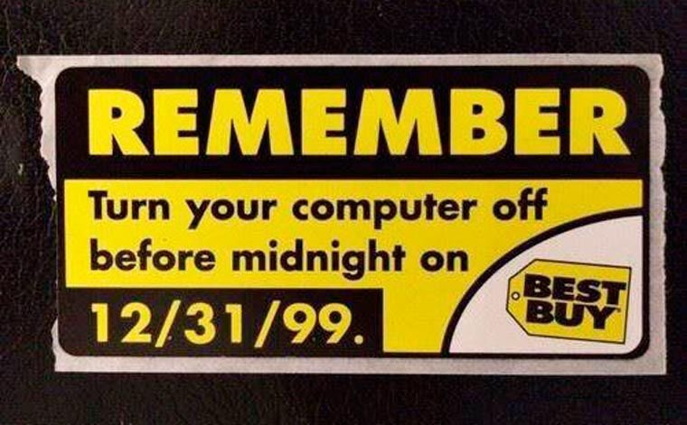
Fear:
The world is always ending
“The world is always ending, and the end is always being averted, by love or foolishness or just plain old dumb luck.”
-- Neil Gaiman
“The world is always ending; the exact date depends on when you came into it.”
-- Arthur Miller

Slide 13
Hope

Slide 14
Congress 2023-2024

Slide 15
factions
Rs: Ongoing battle between different factions:
Establishment = endangered species?
“Top of the Ticket” – compare Biden (Ds); Nikki Haley (Rs)
House - Reps Cheney, Kinzinger, McCarthy; Speaker Johnson
Senate - Sasse, Portman, Romney, Murkowski, Collins, McConnell
Policy-based: Fiscal conservatives; religious conservatives; libertarians; moderates
Power-based:
Dallas Morning News: Anti-Trumpers (see Group of 100); Sometimes-Trumpers (Mitch McConnell; Nikki Haley); Always Trumpers
Wash Post: Trumpists; Accountability Caucus (supported impeaching Trump); Pro-Democracy (affirmed 2020 election results)
Freedom Caucus? = increasingly fractious right-wing mix of both Policy (fiscal/libertarian) and Power?
For more, see https://en.wikipedia.org/wiki/Factions_in_the_Republican_Party_(United_States)
Ds :
Establishment/moderates;
Progressives;
Blue Dogs (fiscal conservatives)
Bipartisanship?
Problem Solvers
Blue Dogs?
Speaker Johnson

Slide 16
HOUSE – Majority ≠ power
218 votes = majority
As of April 15, 2024 – Rs razor-thin majority (218-213 with 4 seats vacant);
Allows Rs max of 2 defections.
Radicals emboldened vs forcing bipartisanship (“have to” vs “want to” bills)
Vacancies – special elections now through June 25th. 3 R seats, 1 D.
Theoretical “worst case” for Rs (unlikely but if all vacancies go D) = 1 vote majority eff June 25th.
Plus possible deaths while on razor’s edge? COVID and the “Gerontocracy” 35% of Reps are over age 60; 13% are over 70 (trending younger; compare vs Senate)
Ds had almost the same margin for 2021-22 (then the smallest since 2001) but held ranks.
The most “Do-Nothing” House since Herbert Hoover was President
As of mid-January 2024, House had passed only 27 bills which became law (only 1931-1932 Congress passed fewer)
Key legislation has since passed with bipartisan support, bypassing right wing (Freedom Caucus)
Bipartisan bills (moderate and longer-lasting) vs Partisan ones (more extreme; shorter shelf life)
November –
2/3 of battleground races are not in Presidential swing states
Either way, expect narrow control (either way) which ironically may continue trend to more bipartisanship

Slide 17
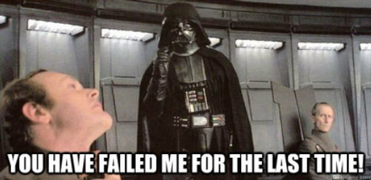
HOUSE - leadership
Speaker of the House: traditionally has huge power
Kevin McCarthy’s “No-Good Terrible Horrible Very Bad Day” 15 votes needed / over 5 days / finished at 1 a.m. Compromise deal included:
No legislation reaches House floor without majority of Rs;
Supermajority (60%) for tax bills // CUTGO; and
“No confidence” votes
Ousted as Speaker for compromising with Ds (debt limit) // led by a block of his own party.
1st time a Speaker has been removed
Mike Johnson (R-La.) is next up,
Mostly because he was new, relatively unknown; hadn’t broken promises or made enemies (yet).
Has since collaborated with Ds to pass key bills (arguably out-McCarthy’d McCarthy)
Appropriations (minibus and omnibus) – without border security or major D concessions
FISA (Foreign Intelligence Surveillance Act) – extended (vs. opposition from left and libertarians)
Ukraine/Israel/Taiwan – supplemental appropriations (vs. varied opposition; included TikTok sell or ban)
Compare:
Nancy Pelosi – held Ds ranks
Kevin McCarthy – chaos and ouster
Mike Johnson – bipartisan pragmatism; unspoken “I dare you”

Slide 18
senate
Ds majority = currently 51 (up from 50/50 in 2021-2022)
Ds = 48 + 3 Independents who caucus with Ds
Rs = 49
“Gerontocracy” -- 56 Senators > age 65 // 30 > age 70
Why majority matters
Agendas and hearings
Voting; Committees (e.g., judiciary committee – SCOTUS, other appointments)
Control change coming - Majority Leader McConnell (led R since 2007) to step down Nov 2024
2024 Senate races – 33 seats open
20 incumbent Ds* + 3 I’s = 23/33 (*Stabenow (D-MI) retiring); Only 10 incumbent R seats up
Key states: Georgia (16); Arizona (11); Wisconsin (10); Michigan (15); Pennsylvania (19); Nevada (6); North Carolina (16) // Other states are currently “solid” or “likely”
Arizona - Rs not spending in Arizona
Rs – big spending coming (unallocated funds)
Ds defending in about 6 Presidential battleground states
Ohio – Bernie Moreno vs. Sherrod Brown
Polling (and dubious modern reliability, especially with Trump voters)
Cash on hand end of 1Q24: Brown ($16m) vs. Moreno ($1.8m)
Montana –Sheehy vs. Tester (polling as a toss-up); Tester is only state-wide D (like Sherrod Brown)
West Virginia (Manchin is not running; apparent lock to go R)
Issue Focus - Local vs. National?
Many Ds seeking referendum on national issues (abortion, pro-democracy / Trump)
While many Rs focusing more on local issues (funding, cost of living)

Slide 19
PROCEDURAL - senate
FILIBUSTER AND “BYRD RULE”
Filibuster
Need 60 votes to prevent minority party (Rs) from blocking legislation
Exception: Budget Reconciliation
Byrd rule (2 Byrds)
(1) Long-term Byrd rule:
Need 60 votes either to
Increase deficit beyond budget window (10-years) or
Change Social Security
Applies even within Reconciliation
Doesn’t appear to apply to net overall tax increases
Note revenue and political roles of effective dates and sunset provisions (e.g., 12-31-2025 for TCJA 2017 individual provisions)
(2) “Germane issues” Byrd rule:
Issues extraneous to budget are subject to filibuster

Slide 20
think nothing can happen in a 50-50 senate?
Key tax LEGISLATION PASSED (late 2020-2022)
Inflation Reduction Act of 2022 (P.L. 117-169 8/16/2022)
Supreme Court Security Funding Act of 2022 (P.L. 117-167 8/9/2022)
CHIPS Act of 2022
Infrastructure Investment and Jobs Act (P.L. 117-58 11/15/2021)
PPP Extension Act of 2021 (P.L. 117-6 3/30/2021)
American Rescue Plan Act of 2021 (P.L. 117-2 3/11/2021)
Consolidated Appropriations Act of 2021 (P.L. 116-260 12/21/2020)

Slide 21
spending and spending (and…)
TCJA 2017 = $1.5 trillion
Fully Republican control (via Reconciliation)
Distribution analysis
2020-21 Coronavirus relief - approx. $6 trillion ($41,870 per federal taxpayer)
Over $4 trillion through 2020
$2.3 trillion to businesses ($670 billion of PPP loans)
$880 billion to workers and families // $650 billion in tax breaks
Additional $1.9 trillion in March 2021
2020/21 “Big Burrito” Omnibus Appropriations Act (additional $1.4 trillion of wide ranging spending)
2021 Infrastructure = $1 trillion
2022 Inflation Reduction Act = $90 billion over 10 years
2023 Consolidated Appropriations Act = $1.7 trillion.
2023 House Rules changes (at least in theory):
“CUTGO” – new spending must be paid for by spending cuts;
Supermajority on taxes = 60% for increases (akin to Senate); and
Debt limit – requires a direct vote
2024 Appropriations = combined $1.8 trillion
$1.2 trillion (Omnibus -- H.R. 2882 – signed March 23, 2024)
$513 billion (Minibus – H.R. 4366 – signed March 23, 2024) – contained 6,628 earmarks totaling $12.7 billion
$95 billion (Supplemental - National Security Bills)
Ukraine ($60.8 B) Israel ($26.4B) and Indo-Pacific ($8.1B)
Sweetener bill: TikTok sell or ban; redirects seized Russian funds to offset Ukraine aid; sanctions (Iranian and Russian officials); limits exports of US tech to make Iranian drones)

Slide 22
RECENT tax-related LEGISLATION OVERVIEW

Slide 23
Irs appropriations (2022-fwd)
Inflation Reduction Act of 2022 (HR 5376) – Supplemental (bonus) Appropriation for IRS
$78.9 billion for FY 2022 to FY 2033
$1.4 billion rescinded in Fiscal Responsibility Act of 2023 (PL 118-5)
$20.2 billion more rescinded in Consolidated Appropriations Act of 2024 (P.L. 118-47)
$58 billion = approximate balance remaining after chip-aways
Or approximately $6 billion extra per year for remaining bonus period (FY 2024-2033)
Chip-aways resulted in @ 31.5% reduction from original IRA 2022 appropriation
Regular Appropriations for IRS
$12.32 billion (for both FY 2023 and FY 2024)
Bonus (IRA 2022) appropriation adds about 50% more per year
IRS spending request for FY 2025: $12.3 billion annual + $104 billion over 10 years

Slide 24
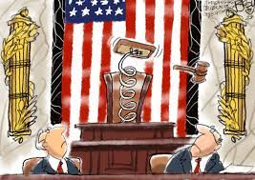
FISCAL RESPONSIBILITY act OF 2023
(P.L. 118-5) – June 3, 2023
Debt limit increased through January 2025 (i.e., after 2024 election)
What Rs got
Caps discretionary spending for FYE24 and FYE25
Rescinds appropriated but unused COVID-19 funds
Reduces IRS funding by $1.4 billion (from the $80 billion provided in Inflation Reduction Act of 2022)
Imposes PAYGO on regulations; waivable by OMB
Ends 2020 student loans payment moratorium effective 9/1/23
Broadens work requirements for adult SNAP recipients with no dependents
Easier federal permits for energy projects (especially Mountain Valley Pipeline)
Major political fight prior to passage
Far-right Rs (Freedom Caucus) were furious; wanted to hold out for larger spending cuts
House Speaker Kevin McCarthy (R-Ca) feared consequences of defaulting on Government obligations; compromised with House Ds, violating one of the deals struck when becoming Speaker
This led to his ouster, a period of chaos, and eventual election of (at least for now) Mike Johnson (R-La.)

Slide 25
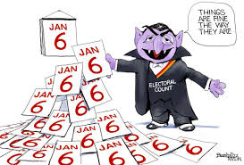
Electoral count reform and
presidential transition improvement act of 2022 (P.L. 117-328, December 29 2022)
Revises Electoral Count Act of 1887
Changes voting, certification, counting and transition in Presidential elections
Goal = prevent chaos like when Donald Trump refused to concede the 2020 presidential election, then sought to have VP Mike Pence block the formal certification of the election results
New State procedures –
Governor (or mayor for DC) generally issues a “Certificate of Ascertainment”
Exceptions for court judgment or superseding state law or constitution
Review of any claims by candidates
Expedited review guaranteed in US District Court
Final order required before electors meet
New rules on Congressional proceedings
VP’s role is “solely ministerial” with no power to “determine, accept reject or otherwise adjudicate or resolve disputes…”
Any objections by members of Congress require written sign-on by at least one-fifth of House members and one-fifth of Senators (previously needed only one from each)
Transition funds made available to more than one candidate if failure to concede within 5 days.

Slide 26
Consolidated appropriations act, 2023
(P.L. 117-328) – December 19, 2022
overview
Ukraine support
See “The budget deal reflects Senate Republican fears of the new GOP House”
Health care (The Health Extenders, Improving Access to Medicare, Medicaid, and CHIP, and Strengthening Public Health Act of 2022)
See “The December Omnibus Bill’s Little Secret: It Was Also a Giant Health Bill”
Electoral reform (Electoral Count Reform Act of 2022)
Tax provisions?
SECURE 2.0
Plus bupkis!!!
And since then…

Slide 27
Consolidated appropriations act, 2023 (cont.)
Secure 2.0
Delay of RMDs
Prior law - beginning at age 72.
Increased to age 73 (2023) then age 75 (2033).
No RMDs for Employer-Sponsored Roth Plans (starting 2024)
Rollover unused 529 (College Savings Plans) funds to Roth IRA; tight limitations apply (amounts and otherwise). (Starting 2024)
Catch-Up Contributions
To Retirement Plans - . Starting in 2025, specific to those aged 60-63, (1) all catch-up contributions will be treated as Roth contributions, and (2) the catch-up limits will be increased to the greater of $10,000 for 150% of the “normal” catch-up limit, inflation adjusted
to IRAs – indexed for inflation starting 2024
Employer Matching Available for Student Loan Payments (starting 2024)
Roth Employer Match Allowed with Plan Amendment (starting 2023)
Penalty Tax For Failed RMDs - reduced from 50% to 25%, or 10% so long as the tax is reported early enough. (starting 2023)
Terminal Illness Exception for Early Withdrawal Penalty - terminally ill person (certified as expected to live less than 7 years) may withdraw retirement assets without a penalty tax (starting 2023)
RMD – Increased Allowability of Life Annuities (starting 2023)
Saver’s Matching by the Government - certain lower income taxpayers will be eligible for up to a 50% government match of contributions to retirement accounts, capped at $2,000 (starting 2027)
Technical Corrections and massive follow-on guidance needed

Slide 28
Inflation reduction act of 2022
overview
History
Infrastructure bill and BBB to bbb to micro-bbb
How did Ds manage to pass this?
Manchin; Rs divided – focusing on policy vs Trump
Tax
Corporate
Corporate AMT
Excise tax on repurchase of corporate stock
Funding IRS
SALT and excess business loans for noncorporate taxpayers (minor effective date changes)

Slide 29
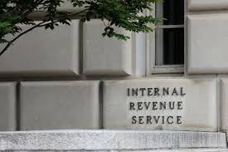
Inflation reduction act of 2022
Irs funding
Total funding increases – about $80 billion over 10 years (through September 30, 2031)
Enforcement: $45,637,400,000
Operations support: $25,326,400,000
Business systems modernization: $4,750,700,000
Taxpayer services: $3,181,500,000
Treasury Inspector General for Tax Administration (TIGTA): $403,000,000
Office of Tax Policy (Treasury): $104,533,803
US Tax Court: $153,000,000
Treasury Department for oversight functions: $50,000,000
Treasury Secretary Yellen memo – gives IRS Commissioner Rettig 6 months to deliver an operational plan with how spending will be spent and metrics by which to judge progress. https://www.axios.com/2022/08/17/yellen-irs-plan-fund
Inflammatory anti-IRS rhetoric since passage
IRS “stockpile of ammunition
Is IRS strike force poised “to shoot some small business person in Iowa?”
Senate Finance hearing – February 15th – confirmation of Daniel Werfel as IRS Commissioner
House Ways & Means Chair – Jason Smith (R-Mo.) – top priority is oversight of “IRS’ plan for the Ds $80 billion windfall”

Slide 30
Inflation reduction act of 2022
Irs funding

Slide 31
CHIPS Act of 2022
$52.7 billion for chip manufacturing and research
$39 billion over 5 years to expand domestic semiconductor manufacturing – incentives (including 25% tax credit) to build, expand and modernize US facilities and equipment
Intel - $20B plant planned in New Albany (near Columbus) – estd. 3,000 workers + 7,000 construction; Production expected to begin in 2025
Companies receiving incentives will be restricted from expanding chip manufacturing in China for 10 years
$11 billion over five years to Department of Commerce to spur R&D in advanced semiconductor manufacturing, invest in new technologies, and expand workforce training
$1.5 billion for “Public Wireless Supply Chain Innovation Fund” to help telecom companies compete with Chinese telecom giant Huawei
$170 billion for scientific research, innovation and space exploration
More than doubles federal government’s prior baseline funding
National Science Foundation – for AI, quantum computing, advanced manufacturing, 6G communications, energy and material science
Strengthen and protect supply chain, manufacturing, communications, computer and pharma
Increase STEM education

Slide 32
Infrastructure investment and jobs act (h.r. 3684)
SHRINKAGE
Comparison with biden proposal (American jobs plan)
Total cost reduced to approx. $1 Trillion (from $2.65 Trillion)
Totally excluded ->
Major reductions ->
 | Biden Proposal | Bipartisan Infrastructure
Housing/schools/buildings | $326B | 0
Long-term care | $400B | 0
Tax Credits (including clean energy) | $424B | 0
R&D / manufacturing | $566B | 0
 | Biden Proposal | Bipartisan Infrastructure
Electric vehicles | $157B | $15B
Water infrastructure | $111B | $55B
Public Transit | $77B | $39B
Reconnecting Communities | $24B | $1B

Slide 33
infrastructure bill (h.r. 3684)
Cryptocurrency reporting
Mandatory yearly tax 1099-B reporting of all “digital transactions”
By all “digital currency brokers” (starting January 2023)
Digital currency broker = any person who (for consideration) regularly provides any service effectuating transfers of digital assets on behalf of another person.
Keep Innovation in America Act (HR 6006) introduced Nov. 18, 2021 to clarify definition
Digital assets – treated as “specified securities”
Means brokers have to track and report customer ID, cost basis and gain/loss
Definition – any “digital representation of value” recorded on a blockchain or similar technology
Cryptocurrencies
Non-fungible tokens (NFTs)?
Digital assets = cash for purposes of structured transaction rules (Code §6050I) – Form 8300 required on receipt of >$10,000 (cash, now including digital assets) in one or multiple transactions).
JCT revenue estimate - $28 billion over 10 years

Slide 34
Unallocated spending
(INFRASTRUCTURE, PANDEMIC, CHIPS and ira)
$1.6 trillion = authorized for climate, infrastructure and energy ($1.1 for direct spending – grants, loans and contracts)
$300 billion = formally awarded by agencies (less than 17%)
Only $125 - $185 billion actually spent
Including “announcements” of large awards = $543 billion (about 50% of direct spending allowed)
Practical consequences
“Saving gunpowder” – look for increase in announcements as election draws nearer
Time pressure for Biden to formally award, especially on areas Trump disfavors (e.g., clean energy)

Slide 35
2020-2021 LEGISLATION

Slide 36
American Rescue Plan Act of 2021 2021 COVID Stimulus - H.R. 1319, P.L. 117-2, (March 22, 2021)
$1.9 Trillion of additional spending/relief
Stimulus payments = $1,400/per
PPP loans and related
Additional funding
Eligibility expanded to include nonprofits with 15% or < lobbying activities
COBRA premium assistance added as countable PPP payroll expense
New Restaurant Revitalization Fund – grands to eligible restaurants
Taxes
Tax cuts for low/middle income taxpayers (short-term / 2021)
Extension of Excess Business Loss Limitation
Expand limitation on excess employee remuneration
Unemployment insurance
Extension
Tax relief
Modernization = $2B (modernize system, prevent fraud, ensure fair access)
State and Local Government assistance
Other: Child Care agencies; agricultural, nutritional, water/utility, public health, healthcare testing, mental health, housing, public transportation, disaster relief

Slide 37
THE BIG BURRITO ACT OF 2021**
(** CONSOLIDATED appropriations ACT OF 2021 (h.r. 133))
$2.3 Trillion spending
$900 billion – COVID-19 stimulus relief
$1.4 trillion – “omnibus” spending
Total exceeds $2.2 Trillion CARES Act (March 2020)
“We have a record!” 5,593 pages = longest bill ever passed by Congress
Funds the government through FYE 9/30/2021
Since extended to Dec. 3rd
Becomes key 2021 deadline for action (or at least future continuing resolution (C.R.))
Cherry picking non-COVID provisions from the >5,500 pages
Military appropriations (National Defense Authorization Act) included “Corporate Transparency Act” (see next slide)
Tax deductions restored for corporate meal expenses (trade-off for expanding tax credits for working poor/low-income)
Debt forgiveness ($1.3 billion) from federal loans to 44 historically Black colleges/universities
Postponed grants to state/local governments (too divisive to include)

Slide 38
CORPORATE TRANSPARENCY ACT - SUMMARY
National Defense Authorization (NDA) Act (prior H.R. 6395)
House and Senate both passed with veto-proof margins
Trump threatened to veto (over Section 230 – social media)
Passed later as part of Consolidated Appropriations Act of 2021 (prior slide)
NDA Title LXIV = Corporate Transparency Act (CTA)
Applies to “corporation, limited liability company or other similar entity”
Some exceptions apply (publicly traded companies already disclosing to SEC; larger private companies with real operations in the U.S.)
Must disclose individuals who are ≥25% beneficial owners (BOs)
Disclosure is to FinCEN (like FBAR)
Not protected taxpayer info (like IRS) – info available to law enforcement; other agencies
Final Regulations issued 9/29/22 (extensive and complicated – 330 pages)
Effective January 1, 2024
Entities created before 1/1/2024 have until 1/1/2025 to file (big improvement from Prop. Regs.)
Entities created after 1/1/2024 have 30 days from creation to file
Penalties
Willful violations: $500/day (up to $10,000) [civil] and/or up to 2 years in prison [criminal]
Negligence: no penalties (Govt must prove willfulness; caution – expect low “preponderance” threshold like with FBAR; safe harbor
Misuse of Collected Information: up to $250,000 and 5 years in prison [criminal]; other for civil [expect banks to be very careful]

Slide 39
CORPORATE TRANSPARENCY ACT - update
NSBA v. Yellen, Dkt. No. 22-cv-01448 (N.D.Ala. 3/1/2024)
CTA held unconstitutional; relief limited to NSBA members as of 3/1/24
DOJ filed Notice of Appeal (3/11/24) – briefing pending in 11th Circuit Court of Appeals
Other cases pending
Boyle v. Yellen, Dkt No. 2:24-cv-00081 (D.Me. complaint filed 3/15/24)
DOJ motion pending for time to respond to complaint (plaintiff’s response due 5/31/24)
Gargasz v. Yellen, Dkt. No. 23-cv-02468 (N.D.OH complaint filed 12/2023)
Order staying case pending outcome of NSBA appeal (CA11 ) granted 4/17/24
Legislative efforts
House bill (H.R. 8147); Small Business Committee hearing (4/30/24); referred to Financial Services Committee
Senate bill (S.4297) (5/9/24 – the “Repealing Big Brother Overreach Act”)
What to do in the meantime? Mel Brooks (from The Twelve Chairs): “Hope for the best, expect the worst”
Practice
Newly formed companies
Preparing for December 31, 2024 (estimated: 32 million small businesses will need to file)
Lobby, lobby, lobby…
See also: Lee Sheppard, “Beneficial Ownership Reporting and the Constitution,” Tax Notes Federal (March 11, 2024)

Slide 40
So now what???

Slide 41
debt limit, appropriations, and the return of the bad chili

Slide 42
Budget, appropriations and Debt limit
Budget
Sets broad parameters for Congressional revenue (intake and expenditures)
Optional: Congress frequently has not passed one (key advantage = allows “reconciliation” spending)
Prediction:
2024: no budget will pass (election year and split control - House/Senate)
2025: (1) no budget passes unless one party (D or R) takes both House and Senate; (2) If either does, then budget can pass by majority of House and Senate (POTUS does not get a vote); (3) If budget passes, tax bill can clear Senate via “reconciliation” with 51 votes (or 50 if POTUS is same party as Senate majority).
Debt Limit
Each day, the federal government spends more than it takes in (by a LOT), so the debt level continues to increase.
Current law caps the federal debt at $31.4 trillion (during last “fiscal cliff” in 2010 it was $14.3 trillion!).
The U.S. hit that limit in January 2023, so cannot legally borrow more without further legislation.
Congress thus has two choices: (1) Raise the debt ceiling; or (2) Stop spending > revenue (a.k.a. “balance the budget”)
Prediction: more “fun” in Jan. 2025 (see “Return of the Bad Chili” – below)
Appropriations
Annual spending bill – done via series of separate bills; one key = annual government funding
Revenue offsets; procedural requirements apply (House vs. Senate)
Does not specify how Government will pay, just how much (and extent of net revenue cost)
For more, see “Appropriations 101” from Committee for a Responsible Federal Budget
Prediction: theatrics and deja-vu cliff hangers starting around Labor Day 2024

Slide 43
Debt limit (1)
Current Status: extended through January 2025 (i.e., post-election)
Key System Flaw – the Appropriations process sets spending obligations separately and (even worse) before means of payment is established
U.S. Government obligations are backed by its “full faith and credit” and include:
Payment of bondholders
Spending – examples:
Domestic (Social security; Medicaid; Government workers)
Military (Israel, Ukraine, Taiwan + whatever is next)
Key numbers
Current federal debt = $31.46 trillion. Blame game?
George W. Bush + Trump – debt grew by $12.7 trillion
Obama + Biden – debt grew by $13 trillion
For an excellent analysis, see
Sullivan, “The Great Debt Ceiling Showdown of 2023,” Tax Notes Federal (Jan. 23, 2023);
“What is the debt ceiling, and what happens if the U.S. hits it?” NY Times (Jan. 18, 2023).

Slide 44
Debt limit (2)
coming in January 2025: fiscal cliff” part ii
(or “return of the bad chili”)
Fiscal Cliff – Part One (2010)
August 2, 2011 – Budget Control Act of 2011
Plan A (epic fail)
Sequester
August 5, 2011 – Moody’s downgraded US bond ratings from AAA to AA+ (citing political risk and unsustainable debt increase)
Fiscal Cliff – Part Two (debt limit reached January 2023)
Kevin McCarthy Freedom Caucus compromise - leverage for fiscal conservatives
Up/down vote on debt limit
Razor thin R majority (same Ds had 2021-22, but Pelosi had strong control over her MOCs)
June 2023 (or later?) – “extraordinary measures” will run out
Risks
Fitch downgrades US bond rating (Aug. 1, 2023)
Government shutdown
Nonpayment of benefits to elderly, poor, etc.
Military pay and readiness
See https://www.washingtonpost.com/us-policy/2023/01/13/debt-ceiling-gop-plan/
Systemic problem: spending promises shouldn’t be allowed without approving payment methods at the same time!

Slide 45
Appropriations
FYE September 24, 2024 – PASSED IN MARCH 2024
Minibus
Omnibus
Supplemental
FYE September 30, 2025
Regular deadline (September 30, 2024) is about 5 weeks before November election
Predictions
Lots of sabre rattling
Then Continuing Resolutions (CRs) beginning after Labor Day
Either defer into lame duck (November/December 2024) or into early 2025
Possible but very unlikely
Government shutdown
Or heavens forfend, actual appropriations (i.e., passed on time without CRs)

Slide 46
Any tax legislation in 2024 ???

Slide 47
CONVENTIONAL WISDOM
Odd numbered years are for legislation
Even numbered years are for elections
Also - small number of legislative days remaining
Timing
National Conventions (RNC / DNC)
August recess
Labor Day

Slide 48
TAX RELIEF FOR AMERICAN FAMILIES AND WORKERS ACT (H.R. 7024)

Slide 49
TAX RELIEF FOR AMERICAN FAMILIES AND WORKERS ACT (H.R. 7024)
Key provisions
Immediate deduction for R&D (vs. 5-year)
Full and immediate expensing for investments in machines, equipment and vehicles
Small business expensing cap – increase to $1.29m (from $1m)
Reporting for businesses using subcontract labor – increase threshold to $1,000 (from $600)
Expand child tax credit (phased in increase to refundable portion 2023-2025) and other improvements
Low-income housing tax credit improvements
Employee retention tax credit (ERC) – set 1/31/24 deadline for backdated claims ($70 billion revenue raiser)

Slide 50
TAX RELIEF FOR AMERICAN FAMILIES AND WORKERS ACT (H.R. 7024)
STATUS
Passed House (357-70) on January 31, 2024
Received in Senate on February 1, 2024; not yet referred to Senate Finance
Prospects of passage?
Why House wanted to move quickly
Expected change of House control in November 2024
Jason Smith (R-Mo., HWM Chair) – represents rural district, unusually focused on workers and families (vs. businesses/investors)
Why Senate may not (“Rose Garden ceremony”; Rs hope/expect Senate control in November 2024)
Sen. Majority Leader Chuck Schumer (D-NY) wants quick passage
Rs don’t. Sen Mike Crapo (R-Idaho, ranking member on SFC) threatens “hundreds of amendments” to tax bill
Sen. Chuck Grassley (R-Iowa) says it initially looks good, but jeopardizes GOP efforts to extend other parts of TJCA in 2025
“I think from a political standpoint, a lot of Republicans, me included, feel like we’ll have more leverage a year from now than we have today,” Sen. Kevin Cramer (R-N.D.)
Prediction
Ds may force a vote (Washington Post – 5-2-24)
Senate Finance Chair Ron Wyden (D-Ore.) co-authored the bill with Jason Smith
No other significant tax legislation is likely to pass in 2024

Slide 51
EXTENDERS?

Slide 52
TCJA 2017 – Individual provisions
EXPIRING 12/31/2025
Lower individual income tax rates; changed brackets
Standard deduction increased (e.g., $24k MFJ)
Miscellaneous itemized deductions (prev. 2% haircut) eliminated
Child tax credit expansion **
Personal casualty and theft losses disallowed
SALT deduction limited to $10k (MFJ)
Mortgage/home equity interest limited
AMT patch (exemption raised)
Estate/gift/GST tax – base exemption equivalent doubled (to $10m indexed) [effectively means without further legislation, in 1/1/2026 unified EGT credit is cut in half]
Temporary 100% expensing of qualified property placed in service 9/28/17-12/31/2023 [this expires sooner]
** in pending House bill

Slide 53
TCJA 2017 – BUSINESS PROVISIONS
EXPIRING 12/31/2025
Qualified business income (QBI/§199A) deduction (evens field for pass throughs and sole proprietorships vs. huge TCJA corporate rate reductions)
Research and development (R&D)
Bonus depreciation
Business interest expense
Limitation on “excess business losses”
Foreign-derived intangible income and GILTI deduction (to partially offset new FDII and GILTI inclusion in income); foreign tax credit (FTC) election added
NOTE: many TCJA corporate changes were permanent (i.e., don’t sunset)
** in pending House bill

Slide 54
Tax bill and/or extenders - timing
2024? Probably only via the pending House bill (H.R. 7024) (see prior slide)
Earliest: June-July 2024
More likely: after Labor Day (past conventions and August recess)
Conceivable: lame duck (December 2024+)
2025+
Otherwise: reboot and start again in 2025 = the annual running of the lobbyists to Washington
Then probably nothing until 3rd (or more likely 4th) quarter of 2025 or even 1st to 2nd quarter of 2026 (with retroactive effect)

Slide 55
Corporate transparency act: pending legislation

Slide 56
Corporate transparency act:
Pending legislation
Protect Small Business and Prevent Illicit Financial Activity Act (H.R. 5119; S.3625)
Passed House (420-1) on December 12, 2023; currently in Senate (Committee on Banking, Housing and Urban Affairs)
Limited bill -- key provisions:
Clarifies Treasury cannot shorten or otherwise adjust any reporting deadlines
Changes in reporting deadlines
Existing entities: extends due date for CTA reporting to 2 years after Final Regulations are issued
New entities: expands deadline to 90 days (currently 90 days for new 2024 entities and 30 days after)
Changes in beneficial ownership information: shortens deadline to 90 days after change (currently 1 year)
Provision for Reporting Company inability to obtain required information on beneficial owners (draft legislation currently contains typo – should say “prevent” instead of “permit”)
H.R. 8147 (To Repeal the Corporate Transparency Act) (4/29/24)
Sponsor: Rep. Warren Davison (R-OH (Dayton)); 16 co-sponsors (currently all Rs)
Referred to House Financial Services Committee
House Small Business Committee hearing (4/30/24)
S.4297 (“Repealing Big Brother Overreach Act”) (5/9/24)
Sponsor: Sen. Tommy Tuberville; 8 co-sponsors (currently all Rs; includes JD Vance (R-OH)

Slide 57
Legislation 2024-fwd social and other factors (laws follow the people)

Slide 58
policy issues
Economy –
Inflation
Unemployment (low but uneven)
Labor unions - railroad/UPS strikes were narrowly averted (what if another pre Nov.)?
Legislation –
Policy vs. Bacon
Policy successes – watered down because of 50/50 Senate (frustrated Progressives)
Bacon (regional – e.g., Ohio and CHIPs Act)
The return of “earmarking” (2021-forward)
“Pro-democracy” (anti-insurrection movement) – will America still care over 2 years later?
International
The Drumbeat of War:
Funding Ukraine and Israel, or Israel and no Ukraine, or neither?
Trump vs. NATO
Protests (see below)
Russia (Ukraine; space weapons; Novolny’s walk in the Artic Circle)
Redistricting / gerrymandering – e.g., Alabama. See “Redistricting Could Help the Dems Win Back the House” (Politico 9/11/23)

Slide 59
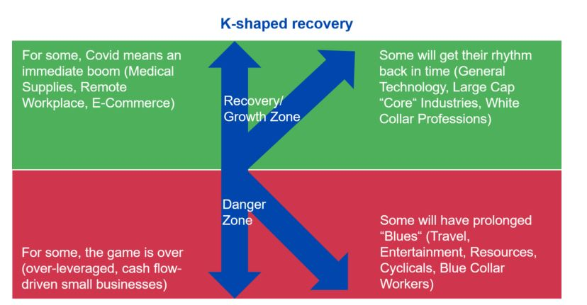
“It’s the Economy, stupid”
Economic recovery –
Overall vs. segments/pockets
V-shaped vs. K-shaped recovery
Gas prices
Inflation
Coronavirus status
Effects on labor available and supply chain
Debt and deficit
Public debt
$27 trillion as of October 2023: in 2020 exceeded GDP for first time since 1946
$23 trillion as of October 2019 (2019 to 2020: >17% increase in one year)
Deficit
CBO projected 2020 federal budget deficit of $3.3 trillion (15.2% of GDP)
Largest since just after WWII (1945), and
Over triple FYE 2019 (as share of GDP)
Update: per CBO, 2023 FYE budget deficit was $1.7 trillion (6.3% of GDP)

Slide 60
SOCIAL issues
GENERAL
The three I’s: inflation, immigration and identity
Inflation: Gas, food prices // Supply chain; labor
Immigration / police reform / guns
Mayorkas impeachment (by one vote, on second try)
Senate passes border bill; House blocks it on Trump’s orders
Can Biden and Ds flip the issue against Rs?
Identity: Trump loyalists; critical race theory
Culture Wars
Conventional wisdom = only the economy really motivates voters
Recent exception = abortion (Dobbs v. Jackson – June 24, 2022; repealed Roe v. Wade)
Mid-term and special elections – Ds won on pro-choice initiatives and candidates
Trump, many Rs tacking to center; can they inoculate themselves from issue?
Arizona – repeal of 1864 law, but 3 new ones coming to replace it
Education – control of schools (Virginia; 2021 state/local elections)
Foreign aid / military support (Ukraine, Taiwan, Israel)

Slide 61
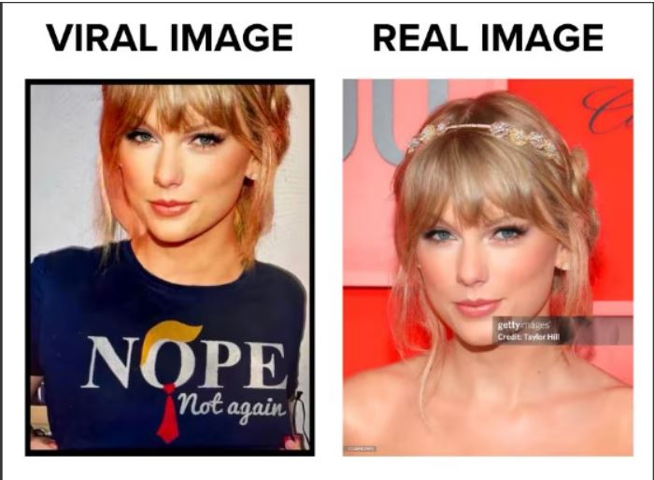
SOCIAL issues
Millennials / Gen X, Y, Z (etc)
Student debt forgiveness = “dual milker”
Gen Z vs. core Trump voters (rural, vocational, military, pure capitalist)
Which group will turn out more on this issue?
Environment
Ds pushed hard in the Inflation Reduction Act
Progressives feel betrayed that compromises were made
Will Ds get voting return on their political capital?
Millennials / Gen X, Y, Z – motivation, apathy or accelerationism?
The Taylor Swift factor
See “Did Taylor Swift Wear a ‘Nope Not Again’ Anti-Trump T-Shirt in 2024”? (Spoiler = no)
And Trump courts Taylor Swift
Israel/Palestinians (see next slide)

Slide 62
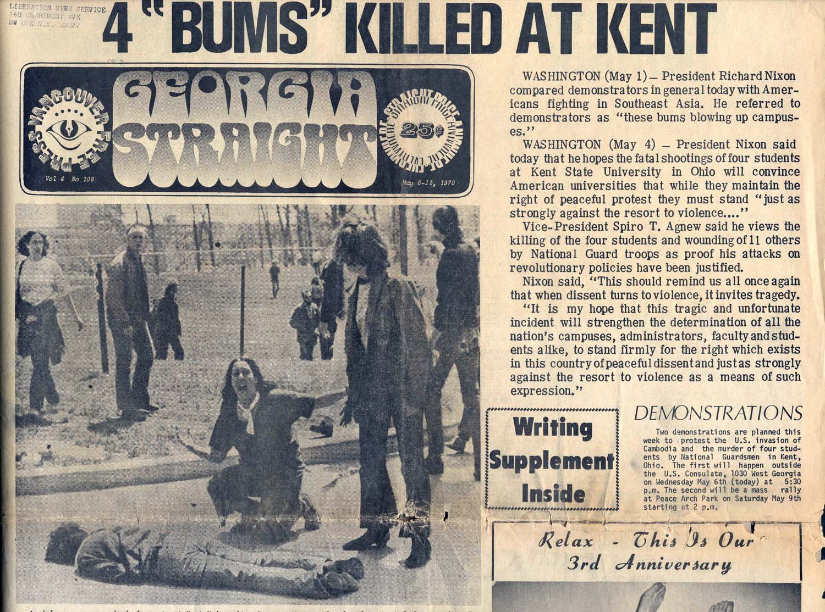
SOCIAL issues
Israel/Palestinians – Student Protests
Columbia, UCLA, etc.
History of student protests in U.S.
Echoes of Kent State protests
Role of Federal Government vs. State (remember Gov. Rhodes?)
Split of public opinion in Kent
Perspective – Biden vs. Trump on handling protests?
“Summer session” 2024 – will protests continue post-graduation?
Political importance of cease fire
Democratic National Convention - 1968 vs 2024?
August 19, 2024 (Chicago)
August 26, 1968 (Chicago)
Polls:
Some young voters are becoming “single issue” voters;
Won’t support Biden due to his support of Israel (e.g., Michigan)
“There are only two good uses for polls”

Slide 63
2024 – immediate concerns

Slide 64
2024 - things we’re worried about “right now”
Tax
House bill
Likely the only tax legislation before Nov. 2024;
Currently stuck in Senate Finance Committee
Extenders – lame duck or retroactive passage in early 2025
Corporate Transparency Act
Due date 12-31-24 for all existing non exempt companies to report
Is any help on the way (courts or Congress)? Hope but don’t expect.
FTC Regs on Non-Competes
Final Regs issued April 23, 2024 – effectively ban most post-employment non-competes
Mostly track 2023 proposed rules (despite over 26,000 comments)
Effective date = 120 days after publication (so late August)
BUT: multiple lawsuits filed seeking temporary injunctions
Prediction: likely a TRO will be granted
In the meantime, learn and plan with caution
Non-competes may be/become voidable;
Ongoing role of non-solicitation; non-disclosure agreements

Slide 65
2025 - fwd TAX LEGISLATION - PROSPECTS

Slide 66
general legislative PREDICTIONS – 2025
“Odd numbered years are for legislation”
Narrow control
Compromise; collaboration;
Longer shelf-life legislation
Wider control
Perceived “Mandate”; more extreme positions;
Shorter shelf-life legislation
Scenarios/dynamics depending on outcome of November election
If one party takes both House and Senate,
Budget can pass
Then reconciliation possible (i.e., with only majority vote in Senate):
If one party takes both House and Senate and wins Presidency:
Reconciliation bill can pass with only majority vote in Senate
AND be enacted without POTUS having contrary veto leverage

Slide 67
specific LEGISLATIVE PREDICTIONS – 2025-2026
Everything in TCJA 2017 will be on the table (= $3.5 - $4.5 trillion of taxes)
Corporate income tax rates
Individual tax brackets
Itemized deductions / increased standard deduction
SALT deduction limitation
continuation past 2025 would be a pay-for
Currently a huge issue for Ds and some Rs (esp NY); failed 2/14 House floor vote
Likely compromise (cap but higher)
199A
Seriously at risk of repeal or revision
But probably (hopefully) tied to C corporation rates (parity)
Estate/gift tax exemption and rates
AMT patch
How much will get paid for (and how)?
TJCA original cost was $1.6 trillion
Making all permanent would cost $4.5 trillion
Individual cuts alone would cost $3.5 trillion (about 75% of the potential cost)
Possible “Early Sunset” (less than 10 years) to keep costs down
If Biden wins in 2024 – may refuse to raise taxes on households making <$400k/yr
Split government = best chance for a more durable, permanent solution

Slide 68
NOVEMBER 2024 ELECTION OUTLOOK

Slide 69
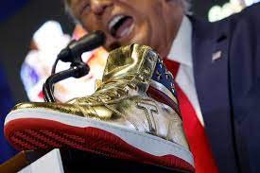
Presidential election 2024 -- REPUBLICANs
Trump trial scorecard
New York
Civil: Trump now faces >$540m in fines, including $354m from NY civil fraud; bond posted; on appeal
Criminal (falsifying business records to cover up “hush money” payments): trial ongoing
Effect if conviction: legal vs. political
“A convicted or imprisoned felon can not only campaign for president and other federal offices, but can also be elected.”
Eugene v. Debs (1920) – ran for president while imprisoned for sedition for speaking out against World War I.
Georgia
Criminal case (state): election interference
Judge allowed prosecutor (Fani Willis) to remain on case
Appeals Court has agreed to consider issue; placed case on hold
Election subversion (DC Federal District Court)
July 2024 - Supreme Court is weighing immunity claim; decision expected in July
Trial date? Currently not expected until after November election
Classified documents (Florida Federal District Court) – Judge Aileen Cannon
Trial date? Was scheduled for August 2023, then pushed to May 20, 2024
Case delayed indefinitely (including Classified Information Procedures Act issues) (May 7, 2024)
Insurrection Clause (Federal Constitution – Fourteenth Amendment)
Issue: can states bar Trump from ballot for having tried to overthrow the government?
Supreme Court says no: Trump v. Anderson, 601 U.S. ___, 144 S.Ct. 662 (March 4, 2024)
Holding: Trump must be allowed on Colorado 2024 ballot
Vote: 8-0 on whether but 5-4 on why
$399 “Never Surrender” Shoes

Slide 70
Presidential election 2024
REPUBLICAN OUTLOOK
Ability to campaign during trial(s)
Social media access
Policy kerfuffles – strong-arming Republicans (especially in House)
NATO
Immigration
Abortion (tacking to center)
Vice Presidential sweepstakes
Nikki Haley (and whether she’s still relevant in 2024)
Sen. JD Vance (R-OH)
May 15th – Trump fundraiser in Cincinnati with Vance
May 5th – RNC fundraiser (audition) at Mar-a-Lago
Gov. Kristi Noem (R-SD)
Sen. Marco Rubio (R-Fla)
Gov. Doug Burgum (R-ND)
Sen. Tim Scott (R-SC)
Rep. Elise Stefanik (R-NY)
July 15-18: Republican National Convention

Slide 71
2024 – DEMOCRAT POTUS OUTLOOK
Biden
Incumbents - historically win unless they face a big primary challenge
Age: Biden will be 82 in November 2024 (Trump will be 78)
Previous oldest POTUS at time sworn in (pre-Biden):
Donald Trump (70)
Ronald Reagan (69)
Scandals vs. Apathy
Special Counsel report (did not recommend indicting Biden on classified documents, but questioned his memory and mental acuity)
Israel vs. Palestinians – damned if you do, damned if you don’t?
Economy is doing ok for many (but maybe not as much for Biden voters)?
Can Ds make political hay out of any of the current flash point issues?
Abortion
Insurrectionists / pro-Democracy
Immigration
Ukraine and Israel – House Rs refusal to fund; lack of support for NATO
Democratic National Convention – a possible lightning rod moment?
See “DNC is Preparing for the Worst in Chicago – Without the Help of the City’s Mayor” Politico (May 10, 2024)

Slide 72
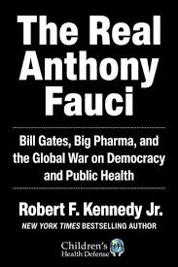
2024 – third party candidate?
“No Labels” -- bipartisanship (Problem Solvers Caucus); sought moderate candidate (turned down by Manchin, Haley others)
Instability in multiparty systems; increased power to fringes
Effects in prior elections
2000 (Bush v. Gore) – did Ralph Nader cost Gore the election?
2016 (Trump beat Hillary Clinton)
6% voted for 3rd and write-in candidates
Libertarian Gary Johnson got >3% of national vote
Green Party nominee Jill Stein got >1%
2020 (Biden beat Trump) – only 2% cast for 3rd party / write-ins
2024
widespread dissatisfaction with both Biden and Trump
How many will/would cast 3rd party or write in?
RFK Jr.
Kennedy family vs RFK Jr; Super Bowl ad
Current polling results = unclear
Some say he takes more votes from Trump (NBC 4/21/24)
Many/most polls and analysts predict otherwise
Not on all State ballots (3rd party vs write-in)
Debates
15% = normal polling threshold
RFK Jr may actually make it to debate stage?

Slide 73
Key upcoming dates

Slide 74
COMING UP
March 1 and March 8 – Appropriation Deadlines (else Govt shutdown)
July 15-18 – Republican Convention (Milwaukee WI)
August 4 – Ohio statutory deadline for certification of candidate
August 19-22 – Democratic Convention (Chicago IL)
September 16 – Presidential Debate #1 (San Marcos TX)
September 25 – Vice-Presidential Debate (Easton PA)
September 30, 2024 – Appropriations (or CR or shutdown)
October 1 – Presidential Debate #2 (Petersburg VA)
October 9 – Presidential Debate #2 (Salt Lake City UT)
November 5 – Presidential Election
December 17 – Electors Cast Their Votes
January 2025 – Debt Limit (again)
December 31, 2025 – Sunset of Individual Provisions from 2017 TCJA

Slide 75
-- appendix-- 2024-2025 estate planning

Slide 76
ESTATE/GIFT TAX INTRODUCTION
The “transfer tax toll bridge”
Date of transfer
Value of what is transferred
Recipient; exceptions
Unified estate/gift tax credit
Unified = life + death (cumulative)
Historical rates (next slide)
Clawback? (no)

Slide 77
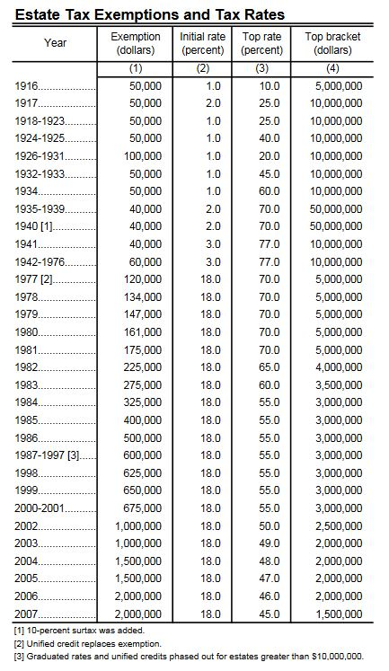
ESTATE TAX (1916-2007)
1935-1983:
60-70% top rate
Unified credit plummeted
As recently as 2000:
55% top rate
$750,000 unified credit
https://www.irs.gov/pub/irs-soi/ninetyestate.pdf

Slide 78
Estate tax (2008-2020)
Year | Exemption equivalent | Initial rate | Top rate | Top bracket
2008 | $ 2,000,000 | 18% | 45% | $1,500,000
2009 | $ 3,500,000 | 18% | 45% | $1,500,000
2010* | $ 5,000,000 | 18% | 35% | $ 500,000
2011 | $ 5,000,000 | 18% | 35% | $ 500,000
2012 | $ 5,120,000 | 18% | 35% | $ 500,000
2013 | $ 5,250,000 | 18% | 40% | $1,000,000
2014 | $ 5,340,000 | 18% | 40% | $1,000,000
2015 | $ 5,430,000 | 18% | 40% | $1,000,000
2016 | $ 5,450,000 | 18% | 40% | $1,000,000
2017 | $ 5,490,000 | 18% | 40% | $1,000,000
2018 | $11,180,000 | 18% | 40% | $1,000,000
2019 | $11,400,000 | 18% | 40% | $1,000,000
2020 | $11,580,000 | 18% | 40% | $1,000,000
Notes:
1. 2010 was elective year (special rules)
2. Gift tax was “de-unified” from 2004-2010. Gift tax credit equivalent (i.e., lifetime gifts) remained $1m for 2002-2010.
3. Exemption equivalent for 2024 is $13,610,000
4. If “sunset” occurs, 2026 exemption equivalent will be half of what it would otherwise be

Slide 79
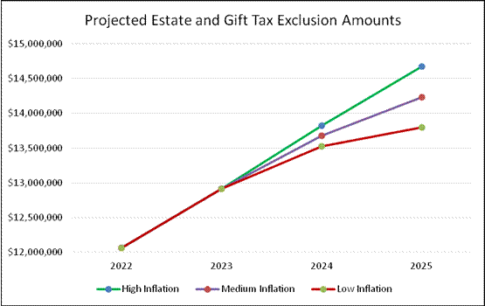
ESTATE TAX: inflation both taketh and giveth
Source: Steve Leimberg's Estate Planning Email Newsletter - Archive Message #2980

Slide 80
ESTATE TAX: STORM CLOUDS ON THE HORIZON?
Will we even get to TCJA “sunset”?
Unified credit scheduled to be cut in half effective 1/1/2026 (returns to $5m + inflation adjustments) – (working estimated $7m)
Election between now and scheduled “sunset” date 2024 (at least)
Little/no prospect of any estate/gift tax legislation in 2024
2025-fwd: what if Ds (or Rs) sweep/bigger? (60 votes in Senate + POTUS, else large compromise)
Bad tax proposal alert: Biden’s prior estate/gift tax proposal
Eliminate basis step-up on death
SBCA strongly opposes = this would be a major “back door” tax increase on small biz owners
If passed would change timing/strategy on lifetime gifts
“Don’t Let the Sun Go Down on Me” -- potential consequences – [Hypothetical example: if exemption reduced from $14m to $7m]
$7m exemption loss (married couple * 2 = >$14m exemption loss
Additional estate tax (approx.)
At current 40% = $2.8m more estate tax
$5.6m if doubled (couple)

Slide 81
Gifting now?
Green light factors:
Unified Credit is at historic high
Just over 3 years left while estate planning is “on sale” (unified credit scheduled to be cut in half 1/1/2026)
Regs: no “claw back” if credit is reduced below amount already gifted
Yellow light factors:
Possible extension of current (high) unified credit?
Prediction:
Unlikely until mid/late-2025 (or later; maybe retroactive),
If/then would be horse-trading for Ds’ priorities (AMT, SALT…)
Repeal of estate tax?
Prediction: unlikely unless Rs both (A) win White House and (B) 60 votes in Senate in 2026
Repeal of basis step-up (i.e., Biden 2021 proposal that was fought back),
Prediction: will eventually be back again as a revenue raiser (“like bad chili”)
We’ll need to fight this again (and maybe again)
School zone (20-35mph) – get ready, but maybe slow down:
Beware gifting things you might need (don’t become dependent on your kids)
SLATs have risks (including divorce, death)
Loss of basis step-up on death for gifts made (many will wait until mid 2025)

Slide 82
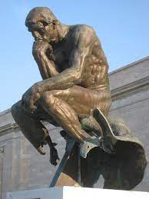
Planning thoughts - overview
Standard planning
“Pure” gifts (current high exemption; valuation discounts)
Control (outright vs. in further trust; nonvoting stock)
Valuation (discounts; effects of pandemic on profits/rents)
Only gifts over 2026 exemption amount are “on sale. Example: $12m gift:
Alternative A: H and W each give $6m
Alternative B: H gives $12; W gives zero
Potential non-reciprocal SLATs
What if one spouse doesn’t own much (step-transaction risks)?
Be very careful in design, communication, and administration
Flexibility / availability vs. §2036
Low/zero remaining exemption planning – are/will still be viable regardless of credit level viable regardless of credit
Estate freezes (GRATs, IDGT sales)
Charitable planning
Income tax planning (especially if basis step-up is lost)

Slide 83
Contact
Matt Kadish
mkadish@frantzward.com
(216) 515 – 1078
Come join us and help!
www.sbca.net

